Slide 1
HelpMeOut

Slide 2
WHO
WE ARE

Slide 3

IN A NUTSHELL
HelpMeOut is a service centered around connecting people who want help with people who want to help

Slide 4
What are the main use cases for your product?
Overview of your project technological and implementation decisions that your team made in the course of developing the product. Some things you might want to include here are:
physical database model
software architecture diagram
Demo of your project
This should be a relatively significant portion of your presentation. We want to see it work. Walk into the presentation with demo fully set up and ready to go.
Wrap up. Some things you could include here are:
What would the next version include?
What is the biggest technological challenge that your team overcame during the course of the project?
What are some big things you learned about working on a team while doing the project?

Slide 5
Use Cases

Slide 6

HelpMeOut is designed specifically for three groups of users:
NEED HELP
WANT TO HELP
WANT TO MAKE
MONEY
Some people genuinely just want to help. HelpMeOut works to help give these people an avenue to help the people around them
Some people genuinely just want to help. HelpMeOut works to help give these people an avenue to help the people around them
Everyone can use a little extra spending money. Help me out brings together people willing to pay for help and people looking for money.

Slide 7
DEVELOPMENT

Slide 8
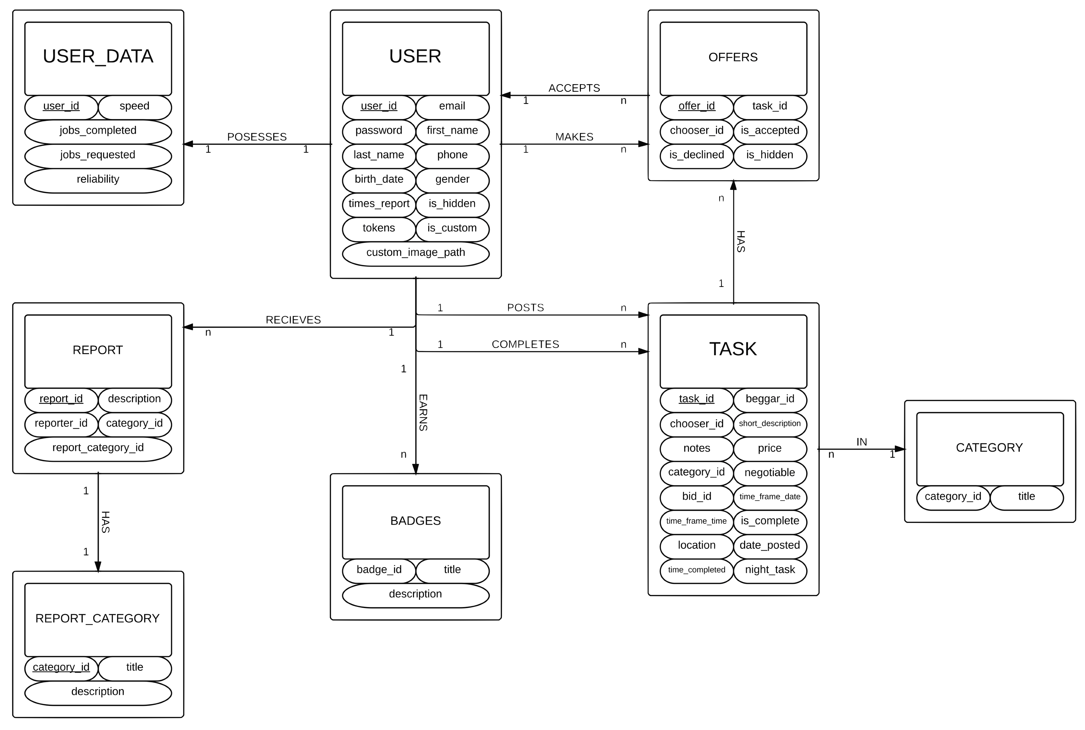
DB Model

Slide 9
DB AUTOMATION
The HelpMeOut database features an assortment of triggers used to automate a variety of operations
Token Deductions
Jobs Completed
Jobs Requested
Night Owl Jobs
Offer Acceptance
User Data Initialization

Slide 10
SOFTWARE ARCHITECTURAL DIAGRAM
WEB SERVICES LAYER
API LAYER
DATABASE LAYER
Data Services
Apache
Application Client
Jquery
JavaScript
& PHP
HTML5
&
CSS3
RESTful API
(Slim Frameword)
Database
Queries
GUI Services
Android Mobile
App Client
SQL

Slide 11




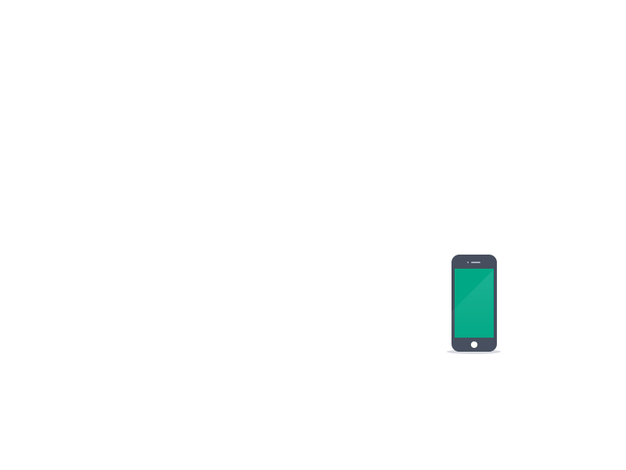
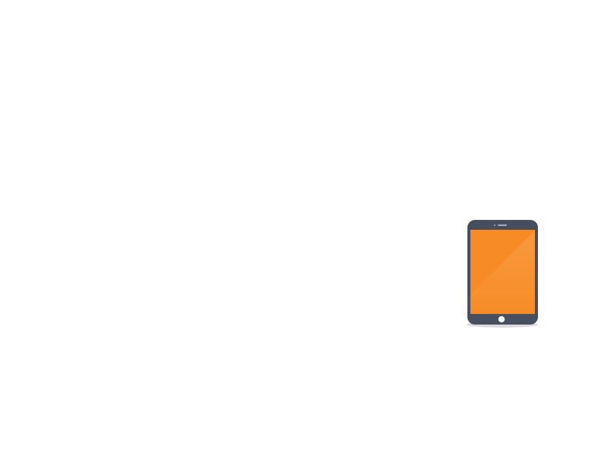
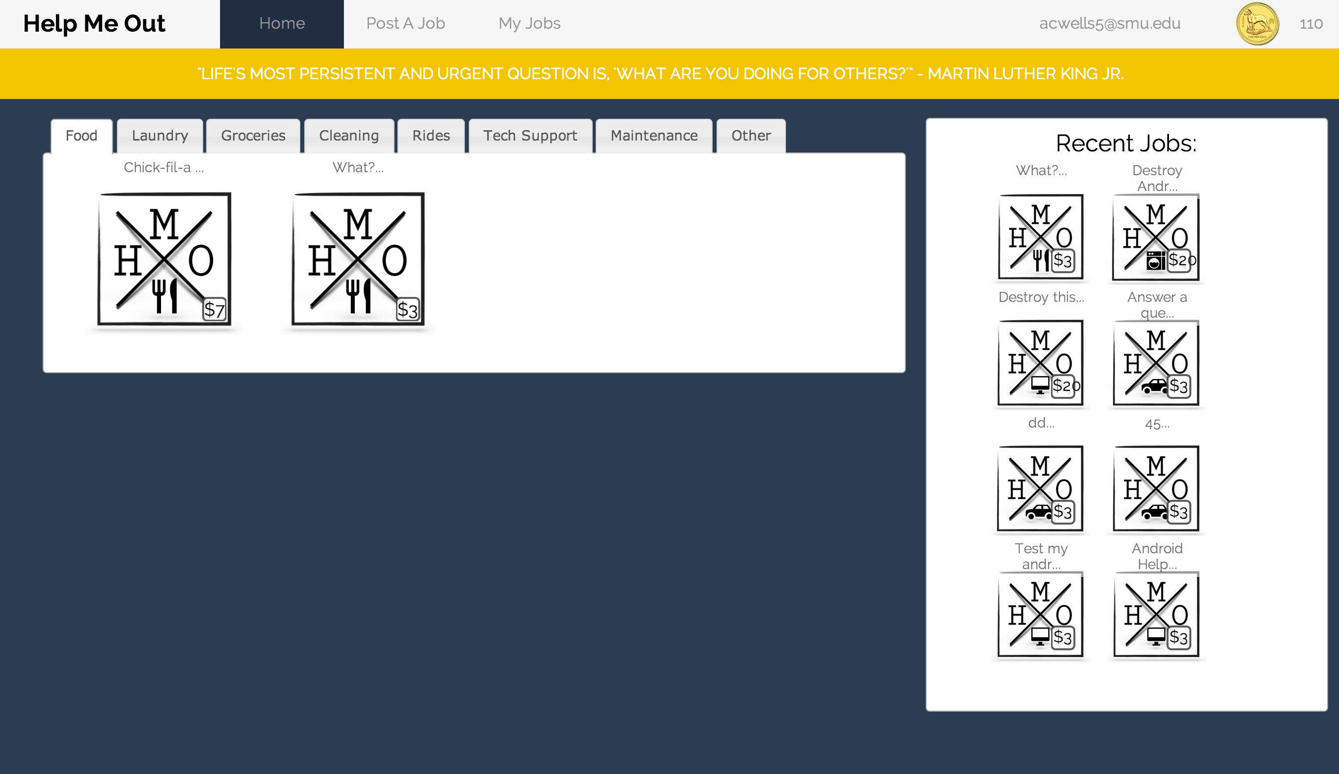
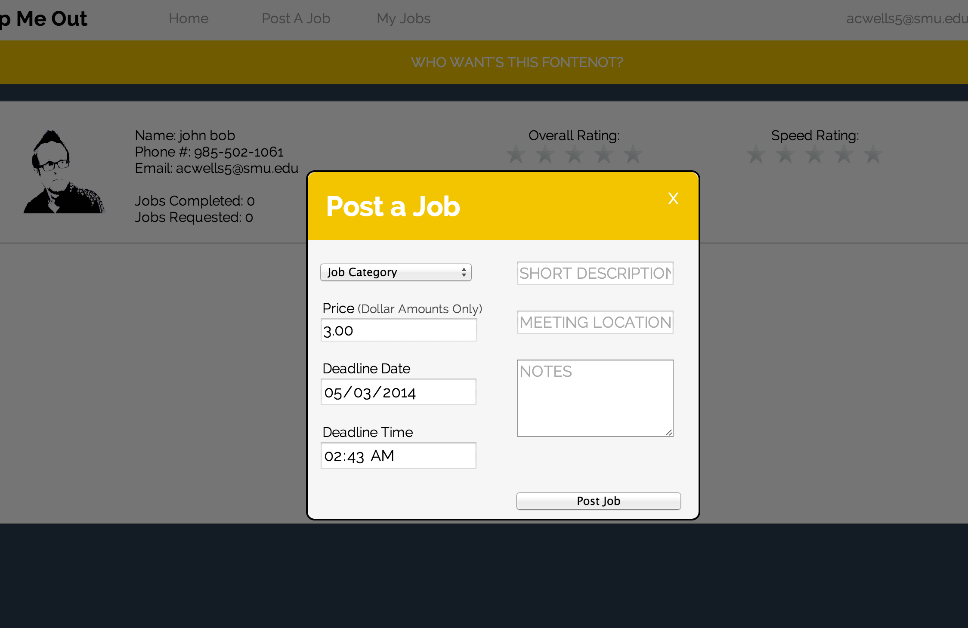
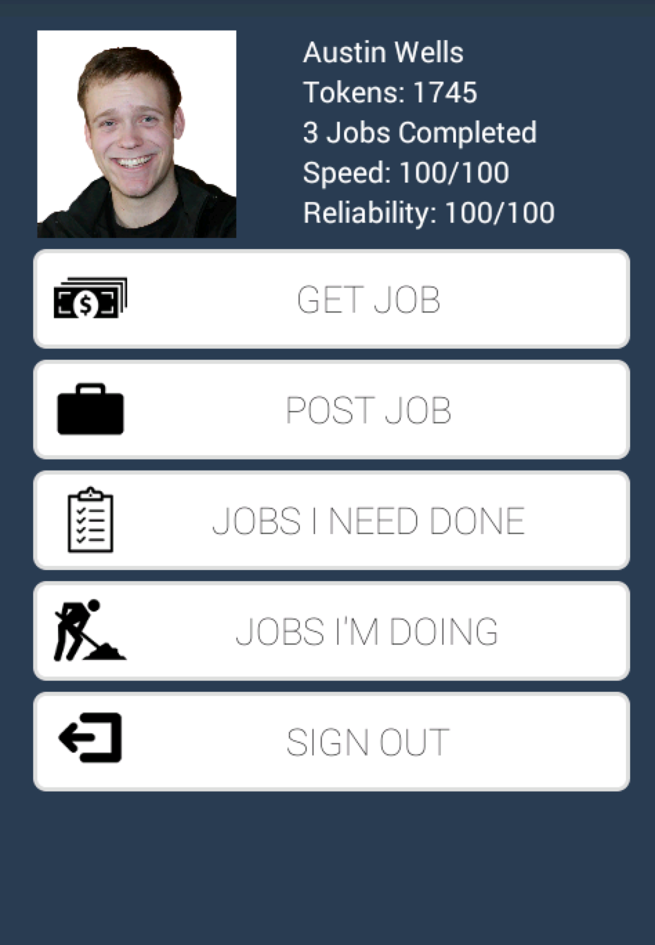
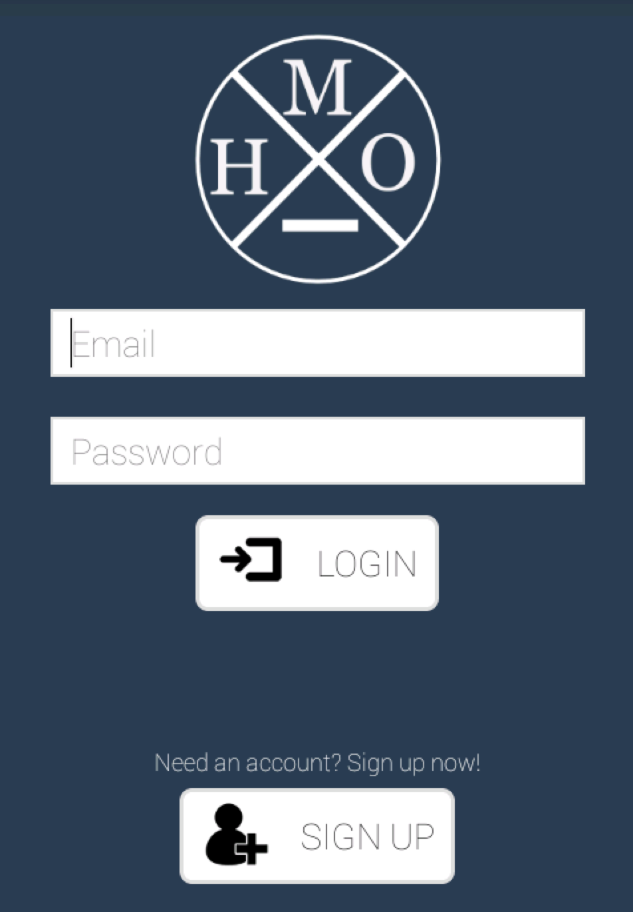

Slide 12
FUTURE
WORK

Slide 13
USER VERIFICATION
NOTIFICATIONS
When designing our application one of the main concerns was user safety. In future iterations we would like to introduce features to verify users identities.
Currently, it’s not possible to know an action has been taken until the account has been refreshed. In the future we would like to implement real time notifications
MAPS
USER REPORTING
Our applications should help people meet, not hinder them. As such, we would like to implement maps showing meeting locations, and the location of a helper
In future iterations, we would like to implement reporting so users who frequently fail to fulfill their obligations can be reported and effectively hidden from HelpMeOut
ADDITIONAL BADGES
Eventually we would like to add additional badges for users who complete tasks of specific categories

Slide 14
So you want to know
what we learned about teamwork?

Slide 15


